Slide 1

Developing regional & personalized recommender systems for respiratory conditions
Asthma and copd are the leading cause in hospitalization in Canada. Only 17% of patients with these respiratory conditions are not symptomatic. The most common factor for asthma exacerbations is the air quality and climatic conditions. 82% of patients are symptomatic and 22% of them experience severe respiratory symptoms 4 times in a week. Currently we do not have any symptom-based predictive model due to lack of data.
Mutlu Yuksel (DAL), Yigit Aydede (SMU), Mohammad Hajizadeh (DAL)

Slide 2
Who we are: Research portal on machine learning for social and health policy (MLPORTAL) https://sites.google.com/view/mlportal/home
We provide a significant methodological expertise on education, migration, health and social policy issues.
We build recommender systems by detecting meaningful patterns in large and complex data sets that are way too large and too complex for humans to make sense of.
We facilitate inferences about causal relationships from observational data and provide frameworks that reveal the underlying factors for better interventions.
We find new and nontraditional data sources that provide reliable information on critical issues.

Slide 3
Who we are:
Mutlu Yuksel PhD, Dalhousie (labour, education), Canada
Andrea Giusto PhD, Dalhousie (forecasting), Canada
Yigit Aydede PhD, Saint Mary’s (population, econometrics, machine learning), Canada
Mevlude Akbulut PhD, Dalhousie (health, education, Children), Canada
Muhammed Hajizadeh PhD, Dalhousie (health, social policy), Canada
Tolga Kaya PhD, ITU (mathematics, machine learning), Turkey
Mehmet Caner PhD, Ohio State (Statistics, Translational Data Analytics, High-dimensional econometrics), USA
Ray MacNeil, Saint Mary's, clari (social policy, health), Canada
Casey Warman PhD, Dalhousie (migration, health), Canada
Joniada Milla PhD, Saint Mary's (social Policy, education), Canada

Slide 4
Why asthma/copd?
3.8 million active asthma and 2 million COPD patients
these respiratory conditions are the leading cause of hospitalization in Canada
21.9% of patients experience asthma symptoms more than four days per week, and 47% of them more than one night per week on average.
only 17% of the asthma patients believe that their asthma is well- controlled
Numbers are for Canada.

Slide 5
The Current state of data on asthma/COPD
Environmental
Triggers
Air Quality and Climatic Data – hard to obtain individual-level online data
Respiratory Symptoms
Not Available
Health Care Utilization
Traditional Surveillance Data on Asthma/COPD
Only 13.5 % of symptomatic patients
utilize health care (Canada)

Slide 6
discovering data on Respiratory symptoms
Method 1: Medical opinion mining on social media platforms (Twitter, FB) and internet search intensities (Google Trends).
The sentiment analysis reveals the aggregate level trend in (chronic) disease in a specific region.
Can be used for developing regional predictive models for the spread of disease (symptoms), which could be useful for health-care resource optimization.
Method 2: Individual-level 7/24 monitoring for symptoms of paid or voluntary participants through mobile health apps.
Symptoms can be self-reported during exacerbations,
Symptoms can be recorded by a device (peak-flow meters or inhalers with Nitric Oxide sensors for respiratory conditions) initiated by the patient.

Slide 7
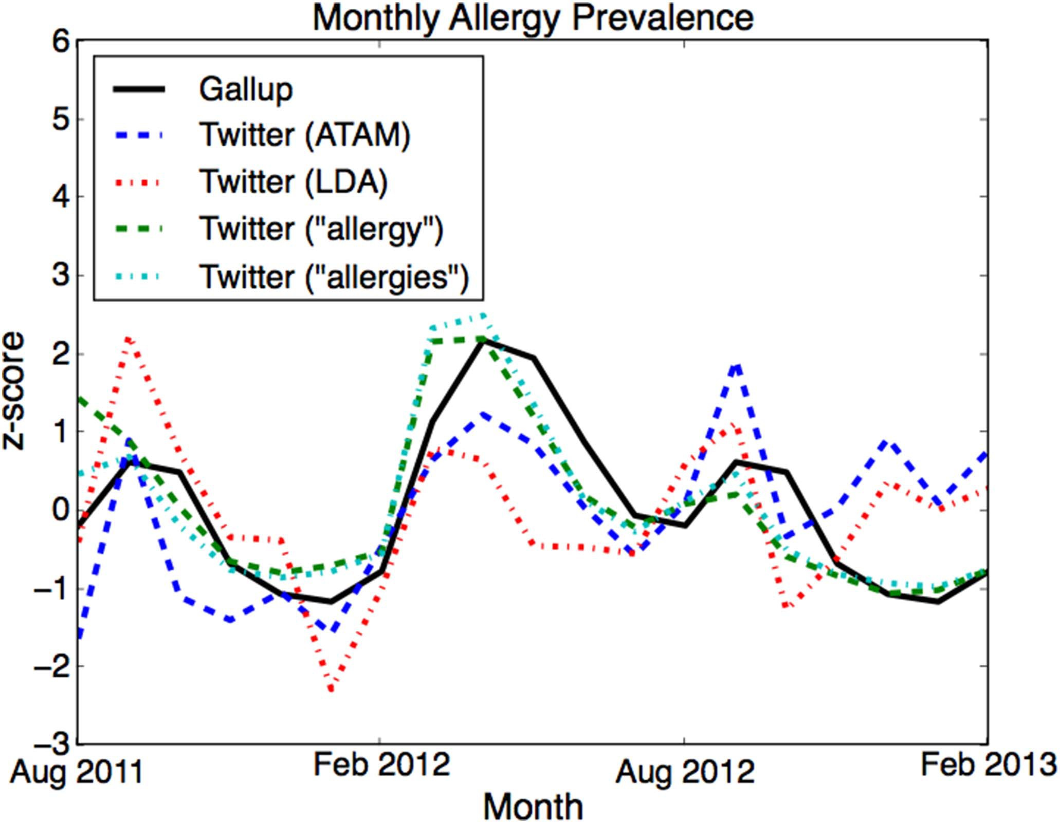
Use of method 1 for disease surveillance - example
Both figures are taken from Paul and Drenze (2014) - University of Maryland and John Hopkins. They use twitter to predict 10 common diseases in USA.
Figure (up): Different models predicting influenza compared to CDC data (solid black line)
Figure (down): The monthly volume of tweets assigned to the allergies topics and keywords alongside the rates given by the Gallup phone survey (solid black line).

Slide 8
Project 1 – New Frontiers Research funding
Asthma is not a curable disease, but many of its symptoms can be averted by proper use of medications and anticipation of environmental triggers
Traditional ways to collect asthma surveillance data are time-consuming and costly to implement regularly. There are often long delays between data collection and information dissemination.
The objective of this study is to identify nontraditional data sources and verify their validity in reflecting respiratory exacerbations in high-population regions by building predictive models using machine learning methods.
If one can develop a model that confirms and predicts the effect of environmental triggers on respiratory conditions, the accurate and timely environmental data with high precision and street-level geographical accuracy, it can help forecast the level of risk for asthma exacerbation and guide timely and targeted interventions at the population and even individual levels.

Slide 9
Project 1: four distinct disciplines
Strong medical expertise in respiratory chronic conditions in general, asthma and chronic disease surveillance systems in particular.
Environmental (climatic and air quality) data in hourly frequencies at finer spatial scales, which includes multiple data streams from satellite- and station-based observed measures and predicted values.
State-of-the-art data mining methods on multiple social networking platforms and internet search queries.
Advance machine learning methods to predict regional asthma symptom trends from our high-dimensional high-frequency environmental data.

Slide 10
Project 2: Developing Individual recommender systems The system can be based on 4 sensory inputs that can frequently be measured in a day:
Pulmonary capacity sensors to measure symptomatic levels.
Peak-flow meters
Sensor-based Inhalers
Physiological sensors (physical activity, VO2-max, caloric burning rate, heart rate etc.)
Wireless Body Area Network (WBAN)
Indoor air quality sensors.
Multiple devices that measures indoor air quality
GPS-based outdoor air quality and climatic measures.
API integration with one of the outdoor AQ and climatic data providers

Slide 11
medical research on individual Rec. systems – 2 examples
Asthma Health App (AHA)(2015), smartphone data collected using ResearchKit
AHA was one of the first of five ResearchKit apps that launched in March 2015 and was developed by the Icahn School of Medicine at Mount Sinai and other partners.
AHA has collected data from about 6K voluntary patients for 21 months.
The symptoms were self-reported.
The main motivation is to collect individual-level data for medical research. The data and the code for the AHA is available upon request for further research.
MyAirCoach - Analysis, modelling and sensing of both physiological and environmental factors for the customized and predictive self-management of Asthma
EU – Horizon2020 Research Project – Started in 2015 and lasts 3 years
http://myaircoach.eu/content/what-myaircoach-project
myAirCoach will an ergonomic and compact sensor-based inhaler that will be connected with the patients’ smart devices
Through an App and a smart inhaler, the central system of myAirCoach will analyse the data and propose tailored asthma plans
myAirCoach’s Self-management Platform for chronic diseases is currently at the final prototype stage before commercialisation, which is planned to be achieved via different vehicles such as the established company of CERTH/ITI (MindMed) but also upon specific investments to attract additional funding

Slide 12
7 Available APPS (none of them operates on ML/AI algorithms)
AsthmaMD: (free; iPhone, Android), which is also compatible with the AsthmaMD peak flow meter. Created by a doctor at the University of California, San Francisco, Medical School, the app tracks medications, asthma triggers, and your action plan.Asthma Buddy: Developed by the National Asthma Council Australia,
Asthma Buddy (free; iPhone, Android) reminds you to take your asthma medications each day, allows you to record an action plan (which you can email to your doctor), and lets you track any changes in your symptoms.
Asthma Track: Part asthma diary, part information collector, asthmaTrack ($2; iPhone) lets you log your symptoms and medication doses, and create graphs of your asthma activity that you can email directly to your doctor
Assist me with inhaler: ($1; iPhone) provides pictures of asthma medications and directions in both English and Spanish on how (and when) to take them.
Asthma Check: (free; iPhone, Android) provides notifications about medicine, peak flow readings, and alerts when you're running low on your asthma medications. It also provides a five-point check for your asthma symptoms and tracks behaviors that can affect your asthma, such as exercise and smoking.
Propeller: (free; iPhone, Android) it sends alerts to your doctor and family members when your asthma symptoms worsen. It also tracks where and when you used your inhaler and its “Daily Asthma Forecast” alerts you to air quality issues and other asthma triggers.
Kid’s App: (free; iPhone, Android), with its adorable little dragon, and Huff & Puff ($8; iPhone, Android), which has videos, quizzes, and games that help kids get more comfortable with their asthma.

Slide 13
Partnership
We have a meeting with NSHA (Steve Carrigan, David Petrie) at SMU on September 20th
We are looking for an active partnership for identifying research questions that can be investigated by nontraditional ways.
We are looking for better and exclusive data sources.
We want the support of the lung association and public circles for our grant applications.

Slide 14
Thank you
https://sites.google.com/view/mlportal/home

